Slide 1
Learning and Equilibrium Structure in Discrete Colonel Blotto
Regret-Matching Implementation with Symmetrisation
Scott Yap
CID: 02017478

Slide 2
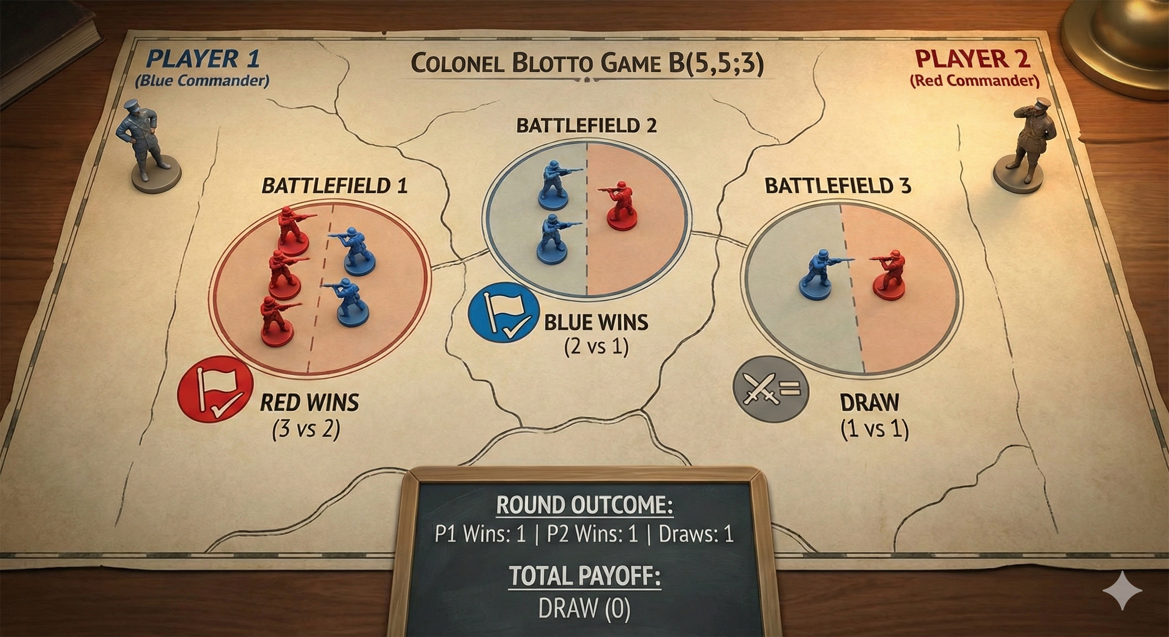

Slide 3
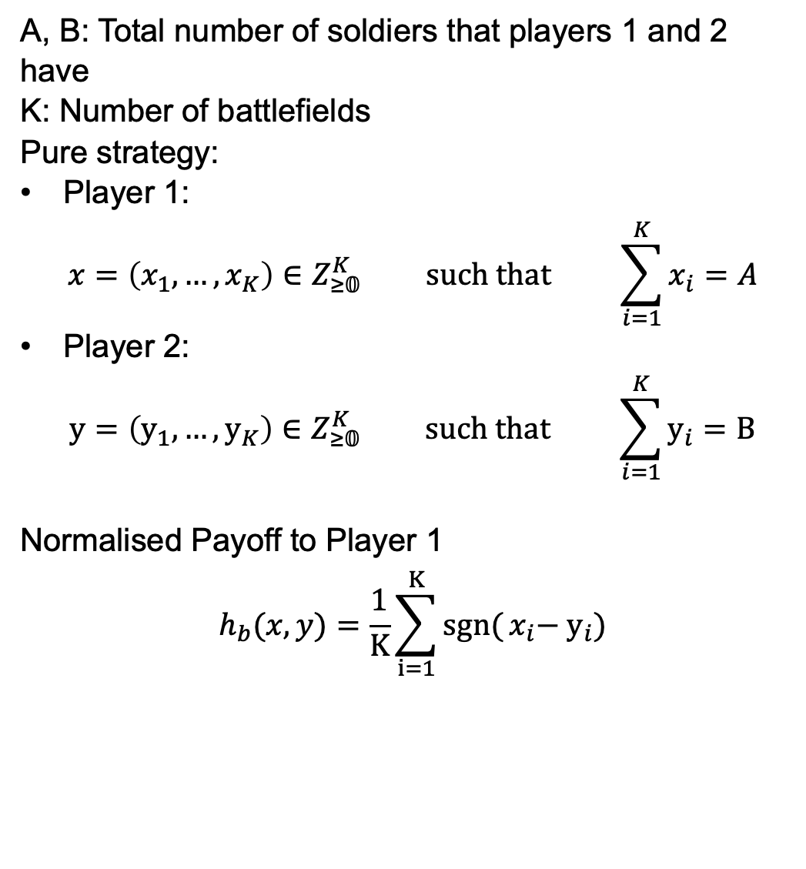
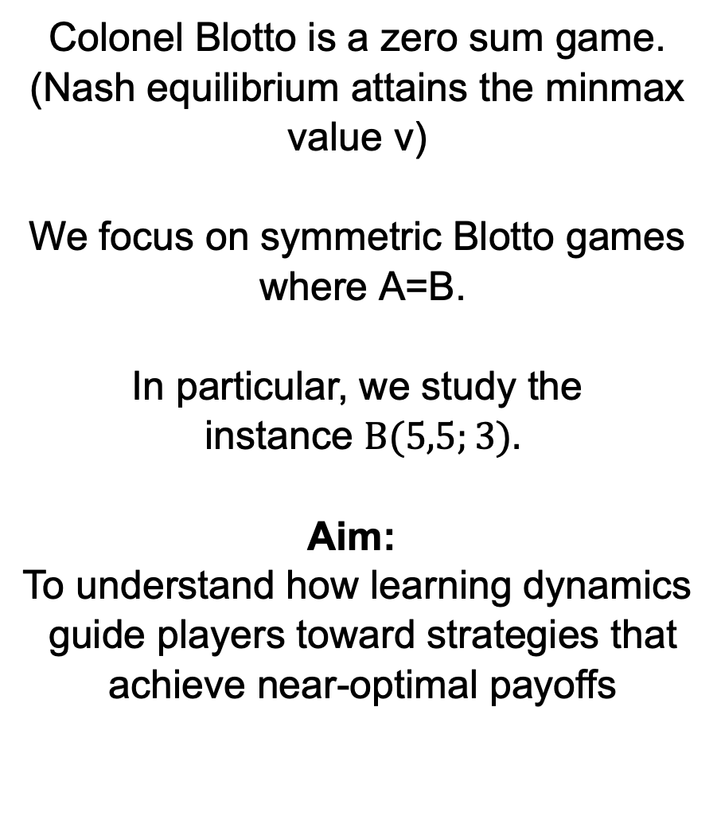
Math Formulation
Colonel Blotto (A,B;K)
A, B: Total number of soldiers that players 1 and 2 have
K: Number of battlefields
Pure strategy:
Player 1:
$$x=\left(x_{1},…,x_{K}\right)∈Z_{≥𝟘}^{K} \text{such} \text{that} \sum_{i=1}^{K}{x_{i}}=A$$
Player 2:
$$y=\left(y_{1},…,y_{K}\right)∈Z_{≥𝟘}^{K} \text{such} \text{that} \sum_{i=1}^{K}{y_{i}}=B$$
Normalised Payoff to Player 1
$$h_{b}(x,y)=\frac{1}{K}\sum_{i=1}^{K}{sgn⁡(}x_{i}−{ y}_{i})$$
Colonel Blotto is a zero sum game. (Nash equilibrium attains the minmax value v)
$\text{We} \text{focus} \text{on} \text{symmetric} \text{Blotto} \text{games} \text{where} \text{A}\text{=}\text{B}$.
$$\text{In} \text{particular}\text{, }\text{we} \text{study} \text{the} \text{instance} B(5,5;3).$$
$$\text{Aim}\text{: }$$
$$\text{To} \text{understand} \text{how} \text{learning} \text{dynamics} \text{guide} \text{players} \text{toward} \text{strategies} \text{that} \text{achieve} \text{near}\text{-}\text{optimal} \text{payoffs}$$

Slide 4



Theory
Algorithm
Hart: solving symmetric Blotto via General Lotto
Neller-Lanctot: no-external regret learning (regret matching)
We evaluate the results from Neller-Lanctot algorithm and compare with Hart’s theoretical results.

Slide 5
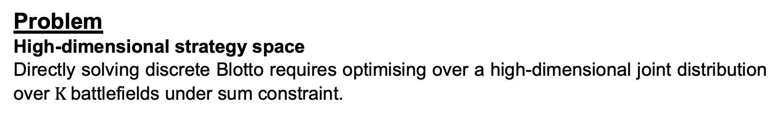
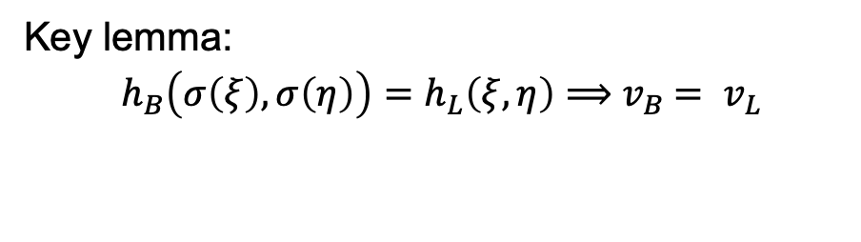
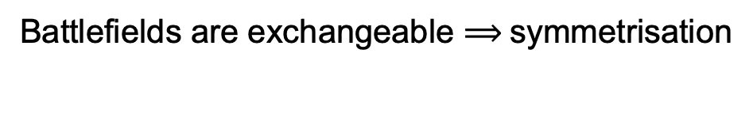
Discrete Colonel Blotto and General Lotto Games by Hart, Sergiu
Motivation
Problem
High-dimensional strategy space
Directly solving discrete Blotto requires optimising over a high-dimensional joint distribution over $K$battlefields under sum constraint.
Solution (Reduction Pipeline)
Battlefields are exchangeable $⟹$ symmetrisation
Colonel Blotto
Colonel Lotto
General Lotto
Feasibility
Symmetrisation
Key lemma:
$$h_{B}\left(σ\left(ξ\right),σ\left(η\right)\right)=h_{L}\left(ξ,η\right)⟹{ v}_{B} = v_{L}$$
Colonel Lotto:
Focus on permutation-invariant play.

Slide 6
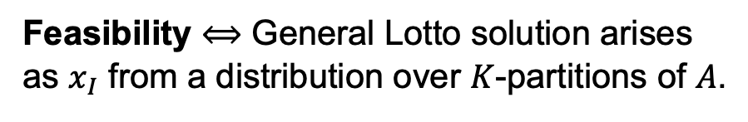
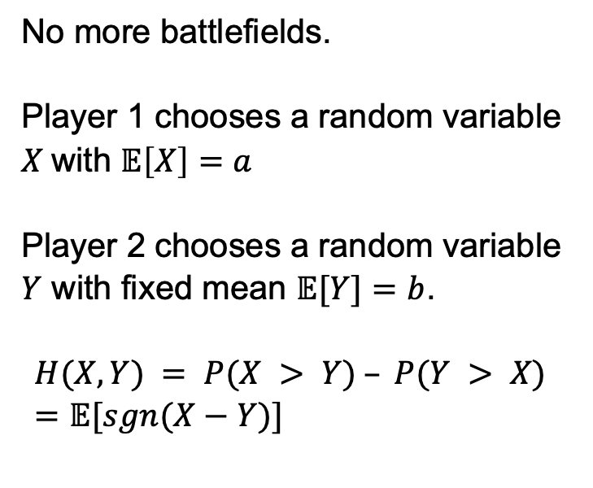
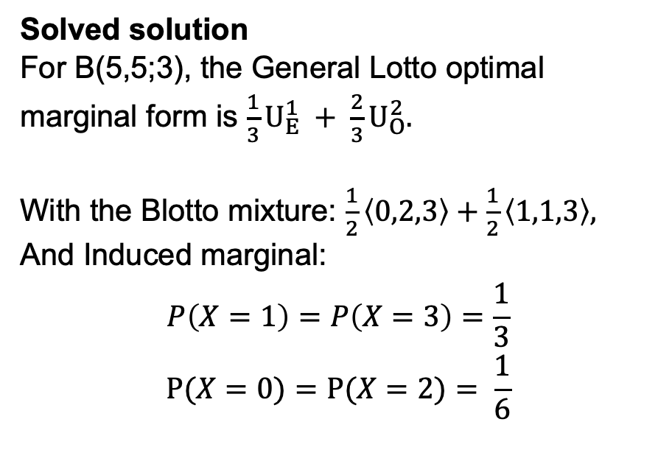
General Lotto and Colonel Solution
Reduction and Feasibility
General Lotto (the relaxation)
Feasibility $⟺$ General Lotto solution arises as $x_{I}$ from a distribution over $K$-partitions of $A$.
No more battlefields.
Player 1 chooses a random variable $X$with $𝔼\left[X\right]=a$
Player 2 chooses a random variable $Y$ with fixed mean $𝔼[Y]=b$.
$$H(X,Y) = P(X > Y) – P(Y > X) =𝔼[sgn⁡(X−Y)]$$
Solved solution
For B(5,5;3), the General Lotto optimal marginal form is $\frac{1}{3}U_{E}^{1} + \frac{2}{3}U_{O}^{2}.$
With the Blotto mixture: $\frac{1}{2}\left\langle 0,2,3\right\rangle +\frac{1}{2}\left\langle 1,1,3\right\rangle ,$
And Induced marginal:
$$P\left(X=1\right)=P\left(X=3\right)=\frac{1}{3}$$
$$Ρ(X=0)=P(X=2)= \frac{1}{6}$$
Hart solves both Continuous and Discrete General Lotto

Slide 7
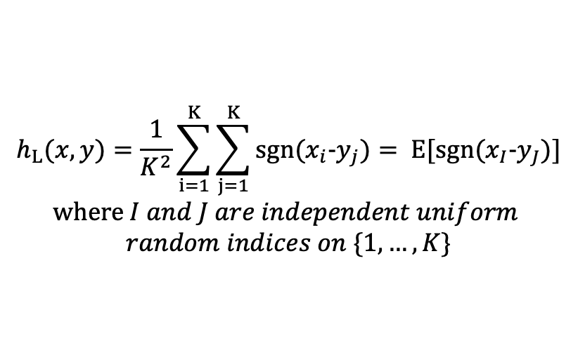

Colonel Lotto and Symmetrisation
Reducing to marginals
Colonel Lotto
Difference to Colonel Blotto
1D Marginal Problem
Instead of comparing battlefield by battlefield.
Each player selects a battlefield uniformly and compares.
View as RV with
mean(X) = A/K, mean(Y) = B/K
$$h_{L}(x,y)=\frac{1}{K^{2}}\sum_{i=1}^{K}{\sum_{j=1}^{K}{sgn(x_{i}-y_{j})}= E[sgn(x_{I}-y_{J})]}$$
$$where I and J are independent uniform$$
$$random indices on \{1,…,K\}$$
Focus on permutation-invariant play.

Slide 8
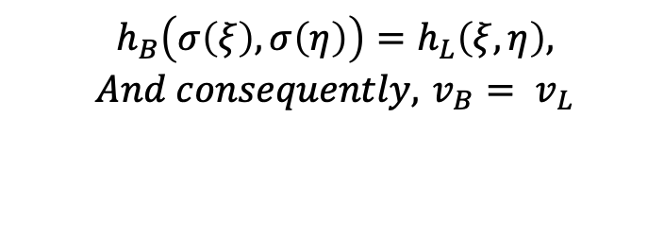
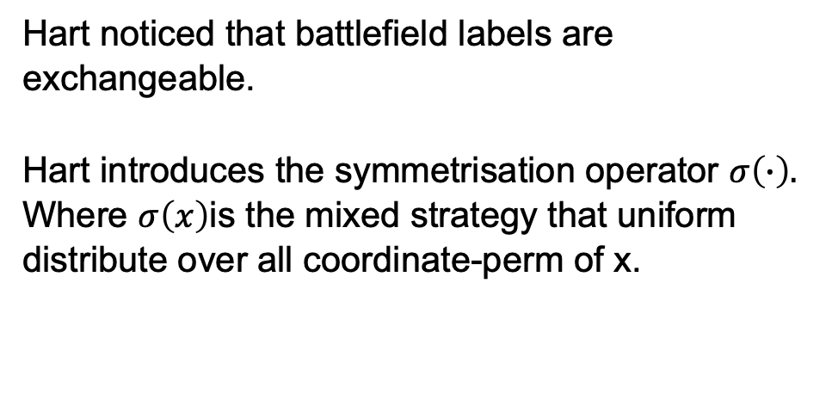
Colonel Lotto and Symmetrisation
Reducing to marginals
Symmetrisation
Symmetrisation Lemma
(payoff equivalence and value preservation)
Hart noticed that battlefield labels are exchangeable.
Hart introduces the symmetrisation operator $σ\left(∙\right).$
Where $σ\left(x\right)$is the mixed strategy that uniform distribute over all coordinate-perm of x.
Connection to Blotto
$$h_{B}\left(σ\left(ξ\right),σ\left(η\right)\right)=h_{L}\left(ξ,η\right), \\ And consequently, { v}_{B} = v_{L}$$
Lotto is the symmetrised version of Blotto.

Slide 9
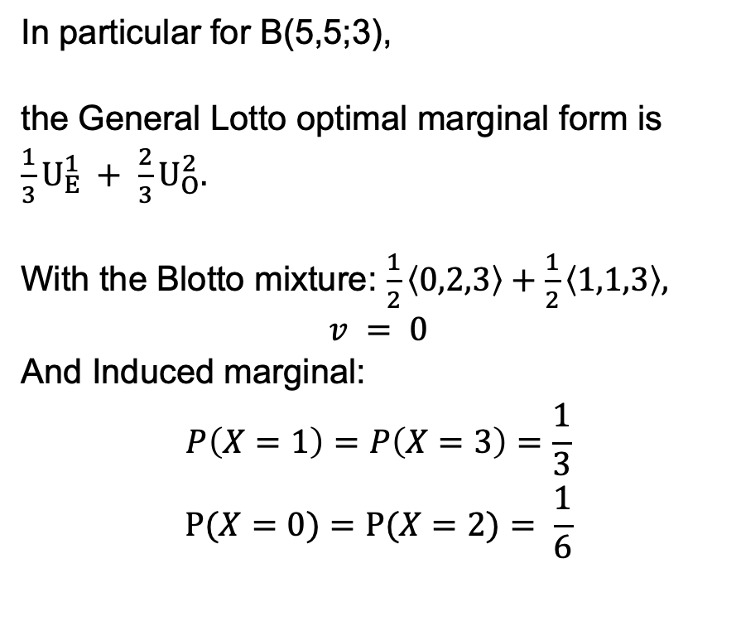
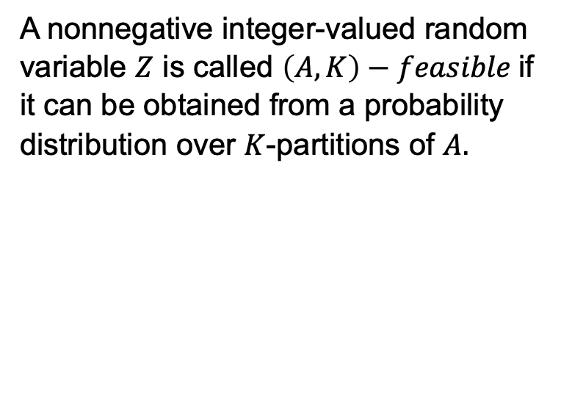
General Lotto and Feasibility
Mapping back to Blotto
Which General Lotto optimal distributions can be implemented by valid Blotto allocations?
Feasibility: (A, K) feasible
For symmetric Blotto games, Hart provides a solved marginal form.
A nonnegative integer-valued random variable $Z$ is called $\left(A,K\right)−feasible$if it can be obtained from a probability distribution over $K$-partitions of $A.$
In particular for B(5,5;3),
the General Lotto optimal marginal form is $\frac{1}{3}U_{E}^{1} + \frac{2}{3}U_{O}^{2}.$
With the Blotto mixture: $\frac{1}{2}\left\langle 0,2,3\right\rangle +\frac{1}{2}\left\langle 1,1,3\right\rangle ,$
$v = 0$
And Induced marginal:
$$P\left(X=1\right)=P\left(X=3\right)=\frac{1}{3}$$
$$Ρ(X=0)=P(X=2)= \frac{1}{6}$$

Slide 10
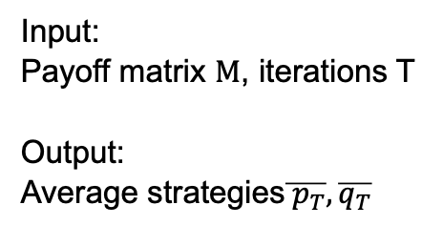
Regret Matching Implementation by Neller and Lanctot
Algorithm
Regret Matching Algorithm
Input:
Payoff matrix $M$, iterations T
Output:
Average strategies$\overline{{ p}_{T}}, \overline{q_{T}}$
Regret-matched strategy
Accumulate average
Sample Play
Regret Update

Slide 11
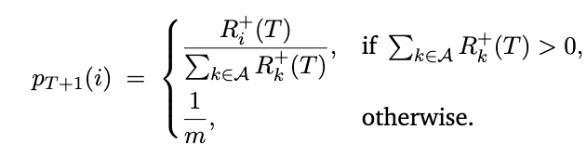
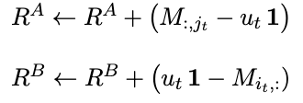
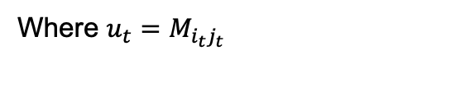
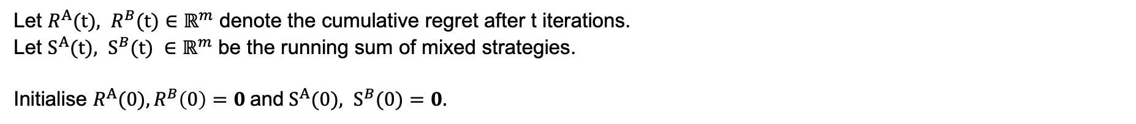
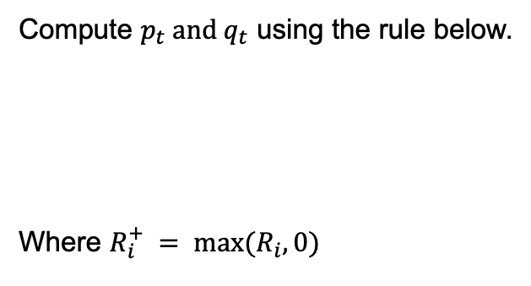
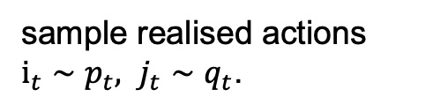
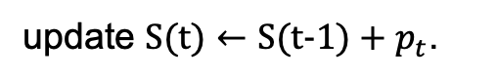
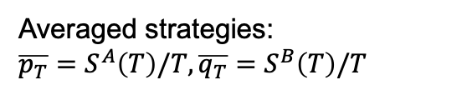
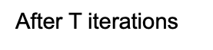
Regret Matching Implementation by Neller and Lanctot
Algorithm
Let $R^{A}(t), R^{B}(t)∈ℝ^{m}$ denote the cumulative regret after t iterations.
Let $S^{A}(t), S^{B}(t) ∈ℝ^{m}$ be the running sum of mixed strategies.
Initialise $R^{A}(0), R^{B}\left(0\right)=0$and${ S}^{A}(0), S^{B}(0)=0.$
Regret-matched strategy
Accumulate average
Sample play
Compute $p_{t} and q_{t}$ using the rule below.
Where $R_{i}^{+} = max(R_{i}, 0)$
update $S(t)←S(t-1)+p_{t}$.
sample realised actions
$i_{t}∼p_{t}, j_{t}∼q_{t}$.
Regret update
Output
After T iterations
Averaged strategies:
$$\overline{p_{T}}=S^{A}\left(T\right)/T, \overline{q_{T}}=S^{B}\left(T\right)/T$$
Where $u_{t}=M_{i_{t}j_{t}}$

Slide 12
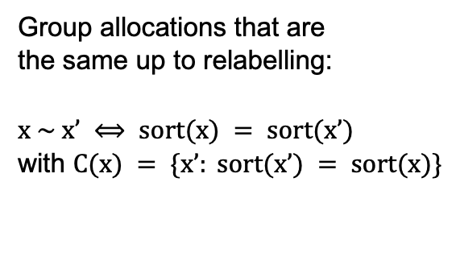
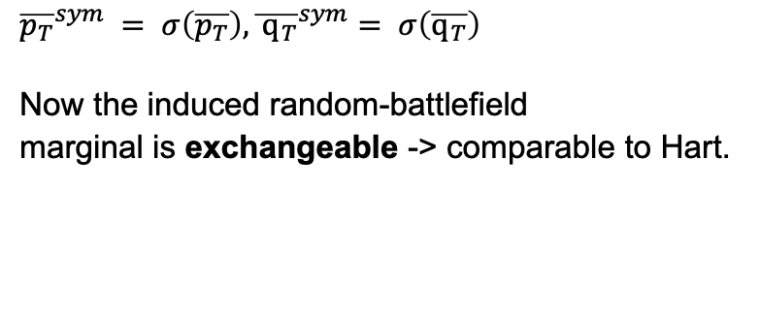
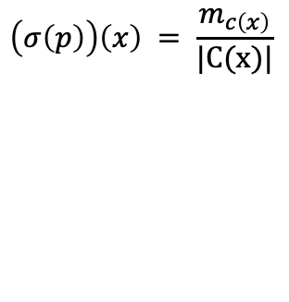
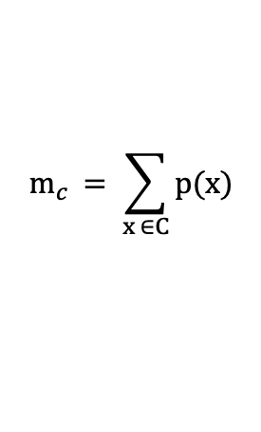
My Addition step to the Regret Matching Implementation
Symmetrisation for Hart Comparison
We symmetrise the time-average $\overline{p_{T}}$ and $\overline{q_{t}}$ by averaging over permutation classes,
obtaining $σ\left(\overline{p_{T}}\right)$ and $σ\left(\overline{q_{T}}\right)$whose induced marginal is directly comparable to Hart’s.
Input: Action list x, and time averaged strategies $\overline{p_{T}}$ and $\overline{q_{T}}$.
Permutation Class
Accumulate class mass
Redistribute uniformly within each class
Group allocations that are
the same up to relabelling:
$x \sim x’ ⟺ sort(x) = sort(x’)$
with $C(x) = \{x’: sort(x’) = sort(x)\}$
$$m_{c }= \sum_{x ∈C}{p(x)}$$
$$\left(σ\left(p\right)\right)\left(x\right) = \frac{m_{c\left(x\right)}}{|C(x)|}$$
Output
$${\overline{p_{T}}}^{sym} = σ\left(\overline{p_{T}}\right),{\overline{ q_{T}}}^{sym}= σ\left(\overline{q_{T}}\right)$$
Now the induced random-battlefield
marginal is exchangeable -> comparable to Hart.

Slide 13
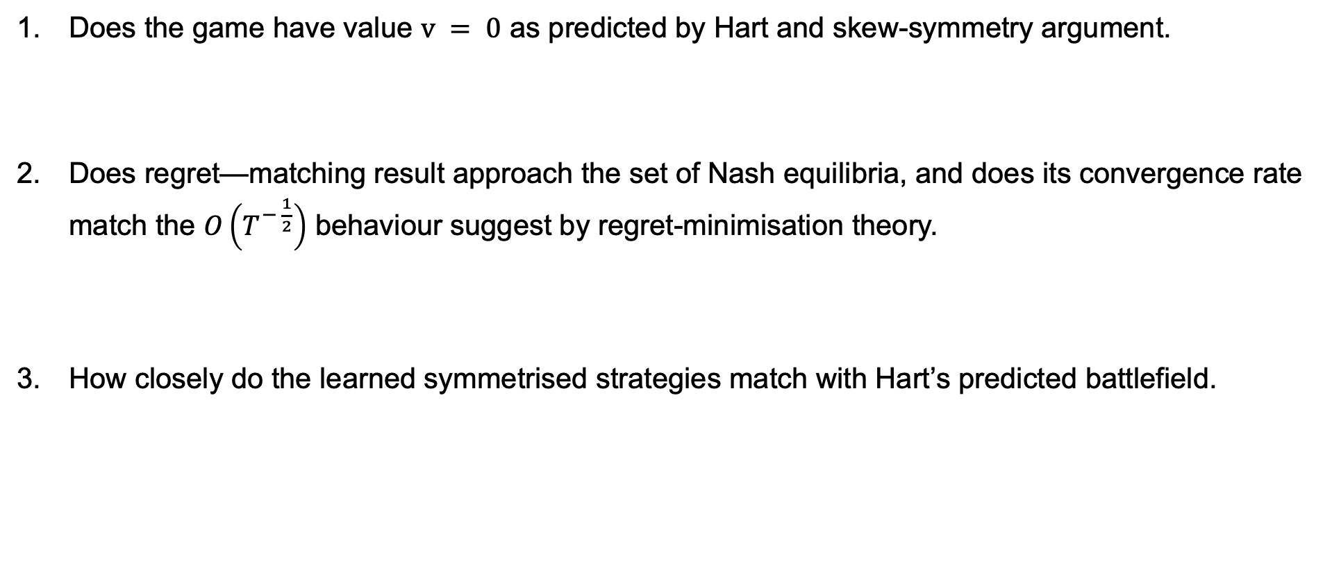
Goal
3 main empirical questions
Does the game have value $v = 0$ as predicted by Hart and skew-symmetry argument.
Does regret—matching result approach the set of Nash equilibria, and does its convergence rate match the $O\left(T^{− \frac{1}{2}}\right)$ behaviour suggest by regret-minimisation theory.
How closely do the learned symmetrised strategies match with Hart’s predicted battlefield.

Slide 14
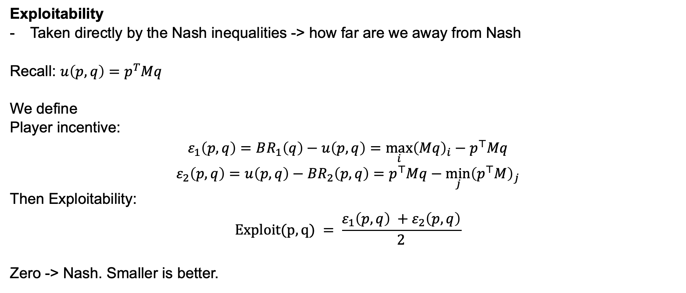
Metrics
Exploitability
Exploitability
Taken directly by the Nash inequalities -> how far are we away from Nash
Recall: $u\left(p,q\right)=p^{T}Mq$
We define
Player incentive:
$$ε_{1}\left(p,q\right)=BR_{1}\left(q\right)−u\left(p,q\right)={\max_{i}\left(Mq\right)}_{i}−p^{⊤}Mq$$
$$ε_{2}\left(p,q\right)=u\left(p,q\right)−BR_{2}\left(p,q\right)=p^{⊤}Mq−{\min_{j}\left(p^{⊤}M\right)}_{j}$$
Then Exploitability:
$$Exploit(p,q) = \frac{ε_{1}\left(p,q\right) +ε_{2}\left(p,q\right)}{2}$$
Zero -> Nash. Smaller is better.

Slide 15
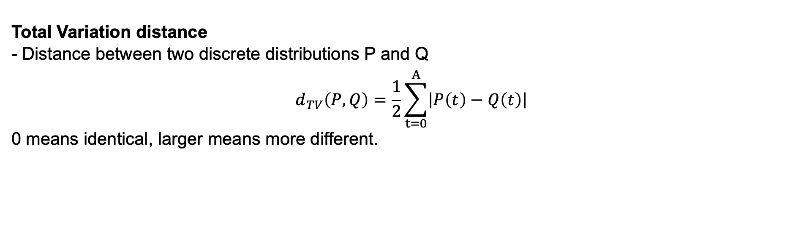
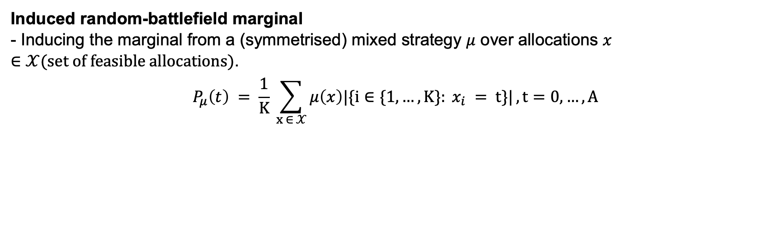
Metrics
Induced random-battlefield marginal and Total Variation distance
Induced random-battlefield marginal
- Inducing the marginal from a (symmetrised) mixed strategy $μ$ over allocations $x ∈𝒳(set of feasible allocations)$.
$$P_{μ}\left(t\right) = \frac{1}{K} \sum_{x ∈ 𝒳}{μ\left(x\right)|\{i∈\{1,…,K\}: x_{i} = t\}|}, t=0,…,A$$
Total Variation distance
- Distance between two discrete distributions P and Q
$$d_{TV}\left(P,Q\right)=\frac{1}{2}\sum_{t=0}^{A}{\left|P\left(t\right)−Q\left(t\right)\right|}$$
0 means identical, larger means more different.

Slide 16
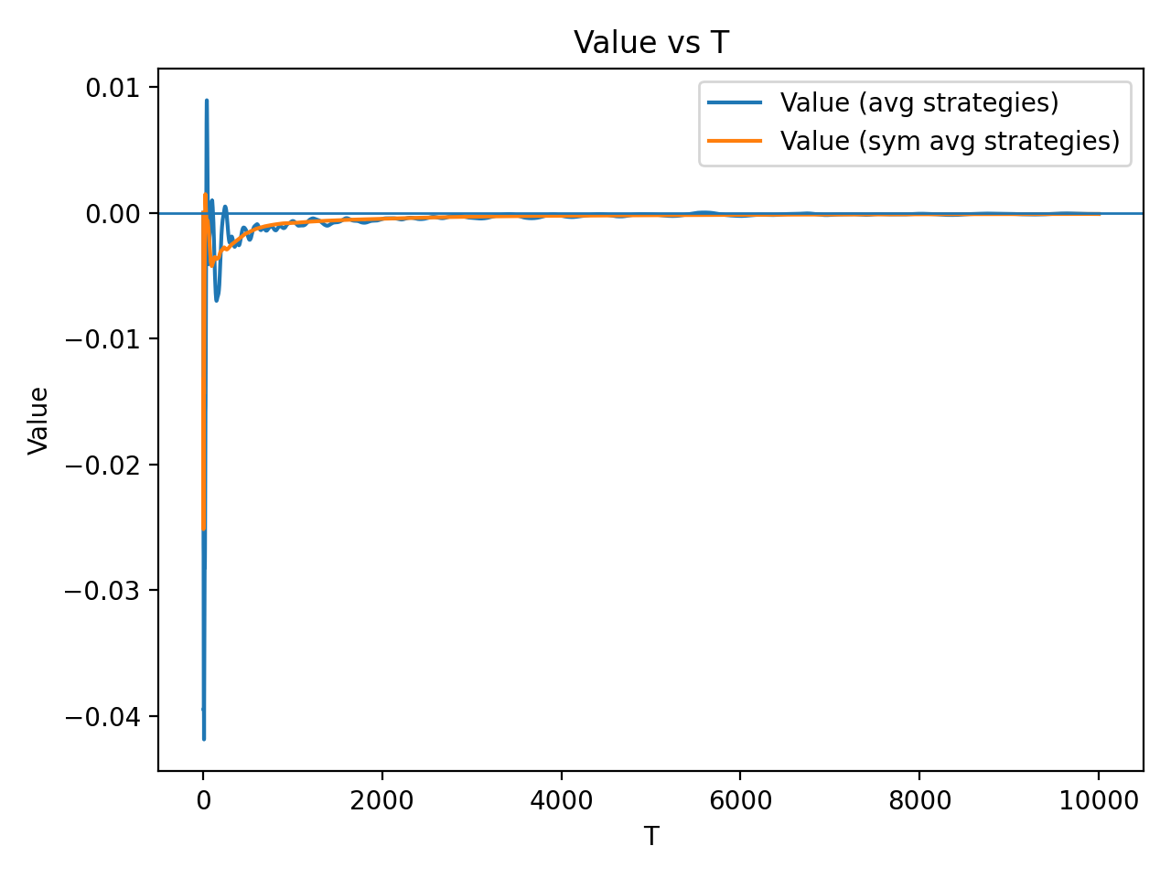
Results
Question 1: Game value = 0

Slide 17
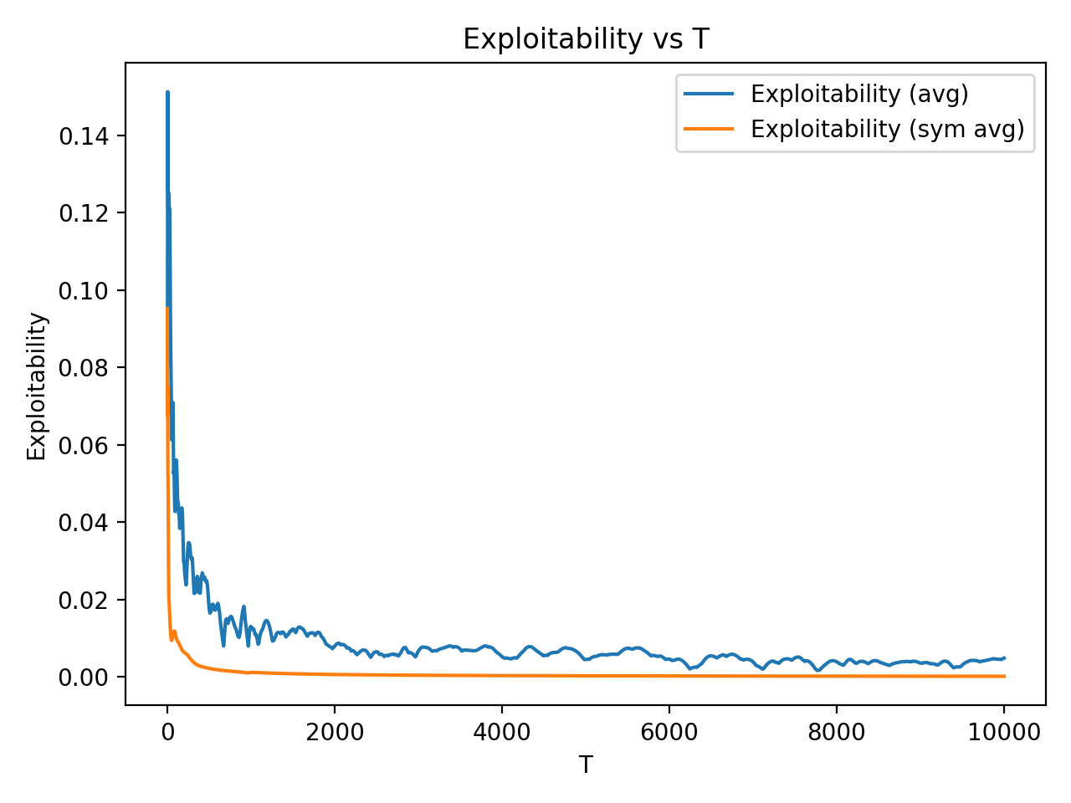
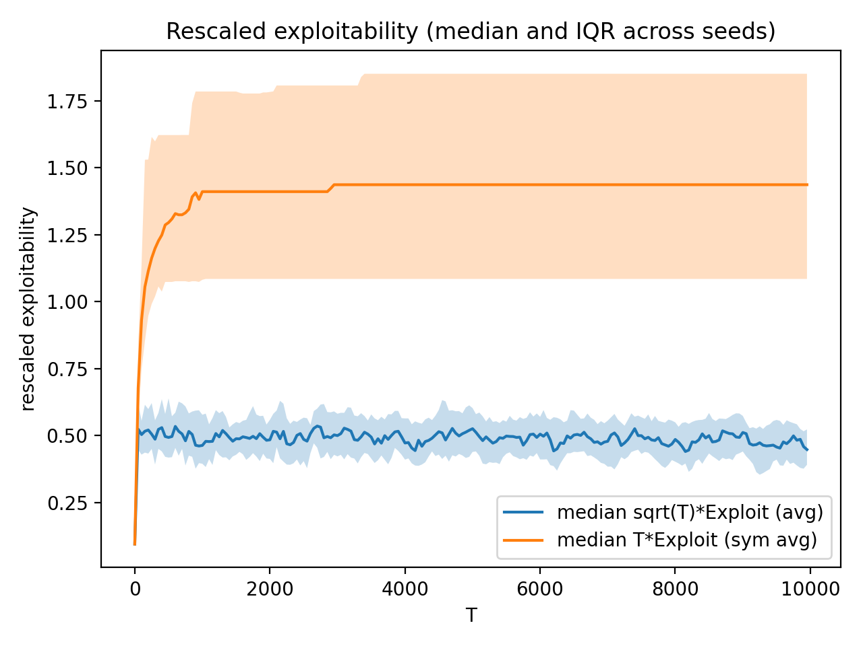
Results
Question 2: Nash verification and convergence rate

Slide 18
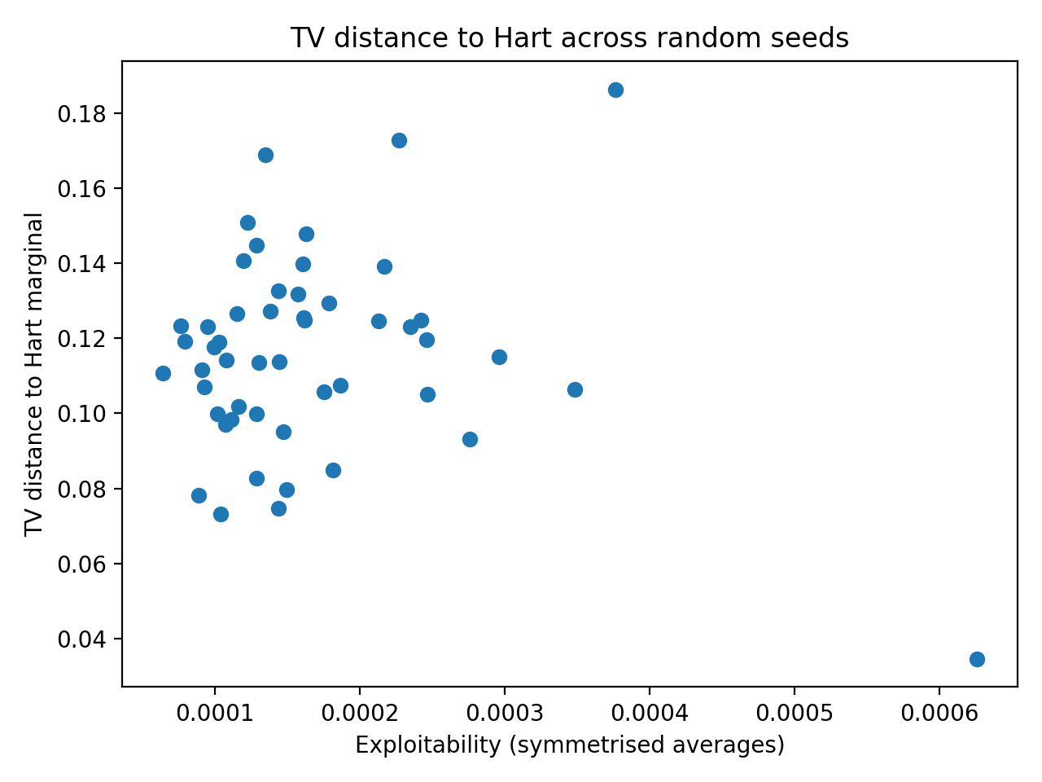
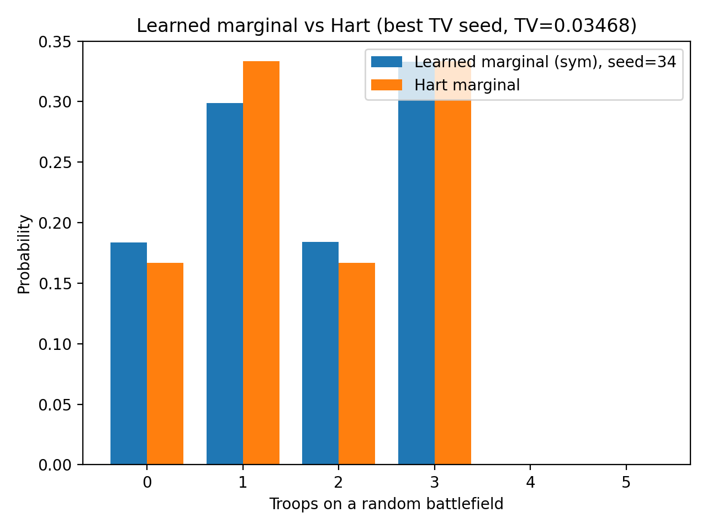
Results
Question 3: Comparison with Hart marginal prediction

Slide 19
Takeaway
Learning and Equilibrium Structure in Discrete Colonel Blotto
Theory predicts structure. Learning finds equilibria.
Main insight (geometry of equilibrium):
The Nash equilibrium is a set, not a single point: different runs converge to different low-exploitability strategies.
Permutation-invariant equilibria form a subset of all equilibria, and Hart’s prediction corresponds to one equilibrium-consistent marginal within that symmetric set, not a unique outcome.
Notes:
Theory (Hart): In the symmetric discrete setting, battlefield labels are exchangeable. Hart exploits this by symmetrising Blotto, reducing it to Colonel/General Lotto, and deriving equilibrium value + equilibrium-consistent marginals.
Algorithm (Neller–Lanctot): I implemented no-external-regret / regret-matching self-play on the finite $\left(S , K\right)=\left(5 , 3\right)$game and evaluated convergence via exploitability.
Verification: The time-averaged strategies reach low exploitability (near the Nash set), consistent with regret-learning theory.
Main insight (geometry of equilibrium): The Nash equilibrium is a set, not a single point: different runs converge to different low-exploitability strategies. The symmetric Nash set lies inside the full Nash set, and Hart’s prediction corresponds to one equilibrium-consistent marginal within that symmetric set, not a unique outcome.

Slide 20
Thank you QnA
Learning and Equilibrium Structure in Discrete Colonel Blotto

